Slide 1

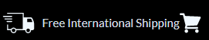
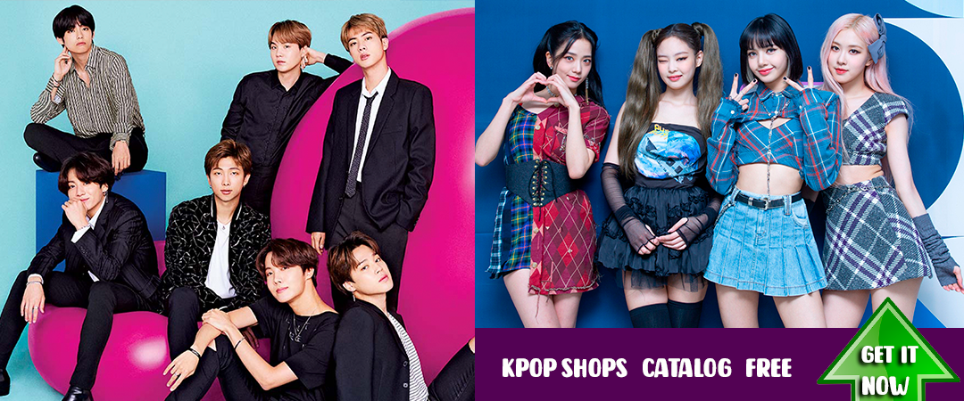
Butter Single album with PREORDER. GET IT NOW
BTS, BLACKPINK,EXO, TWICE BOX KITS AND MORE
GET IT NOW
BlackPink Shop BTS Shop Kpop Oufits K-dramas Shop Anime SHOP EBAY Shop ALIEXPRESS Shop

Slide 2
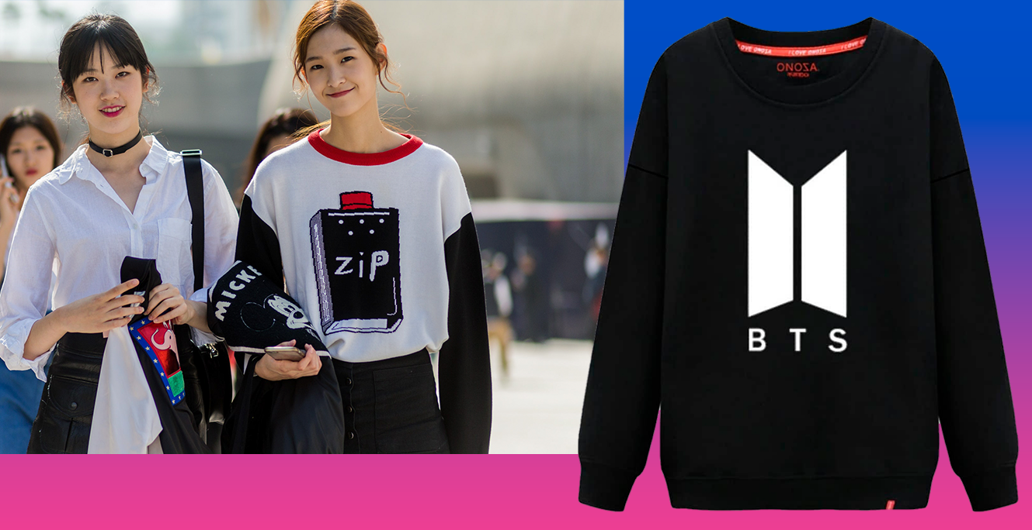
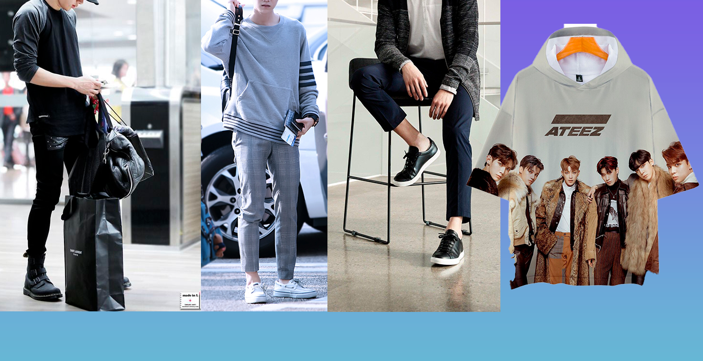
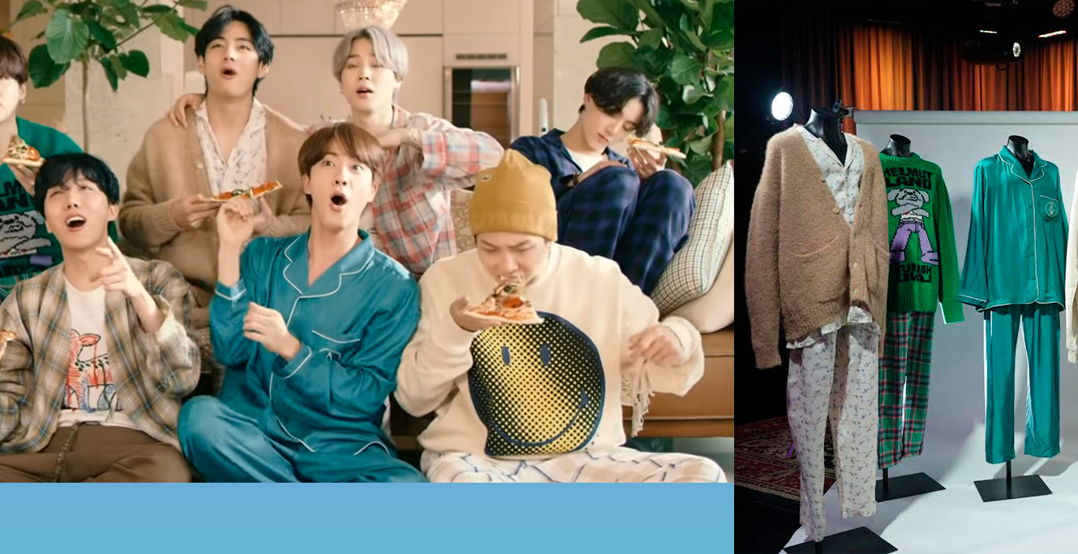
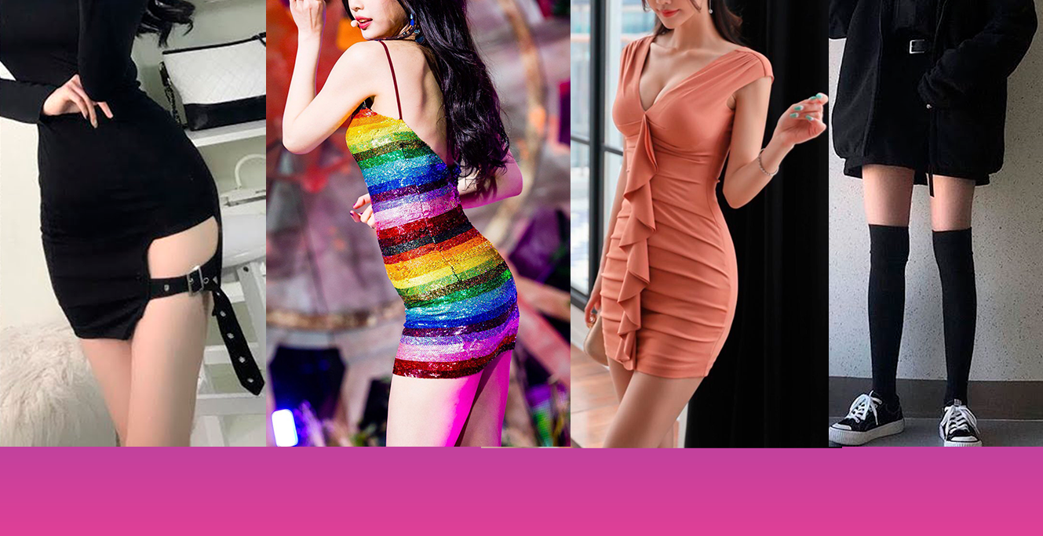
Butter Single album with PREORDER. GET IT NOW
KPOP OUTFITS
KPOP CASUAL WEAR
KPOP SPECIAL EDITIONS
KPOP FASHION

Slide 3
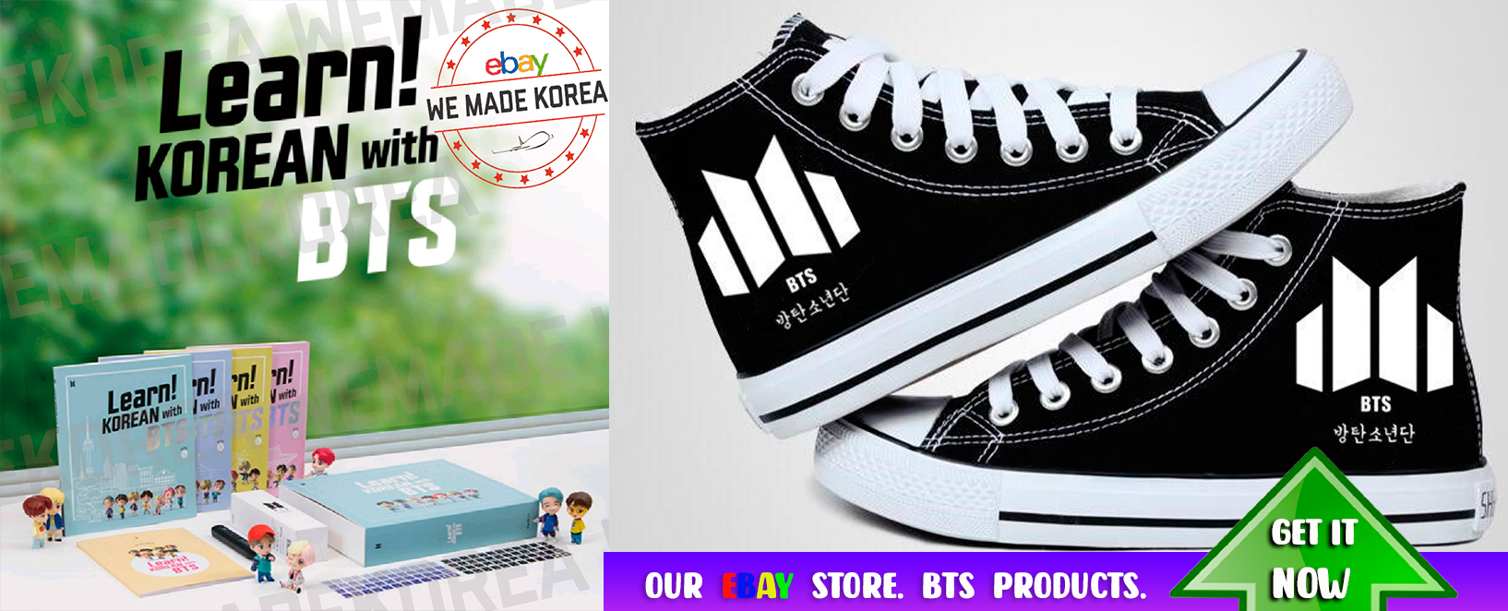
Butter Single album with PREORDER. GET IT NOW

Slide 4
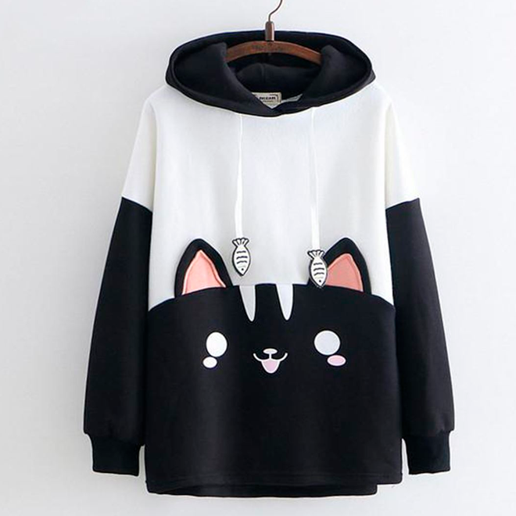
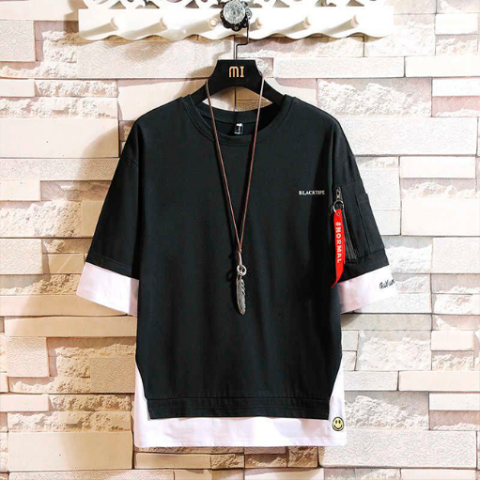
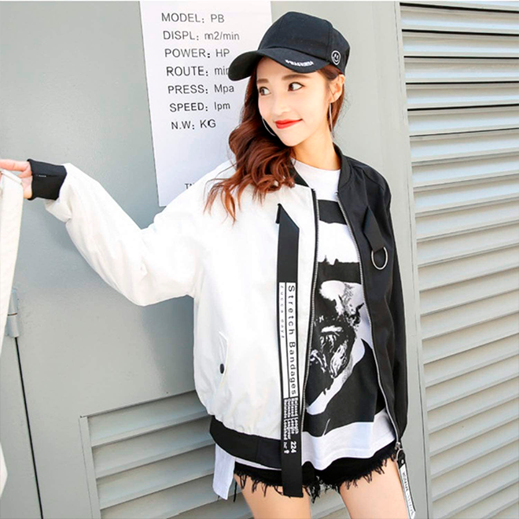
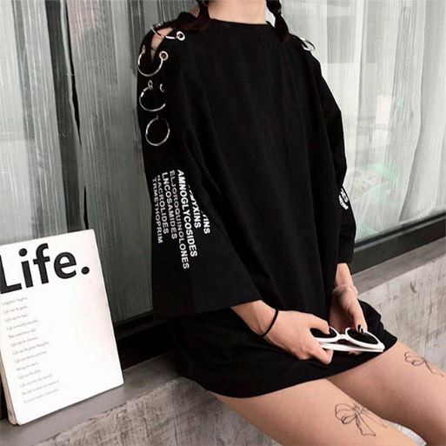
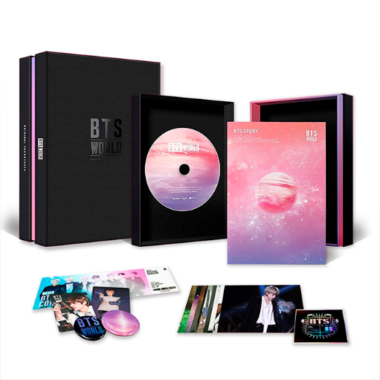
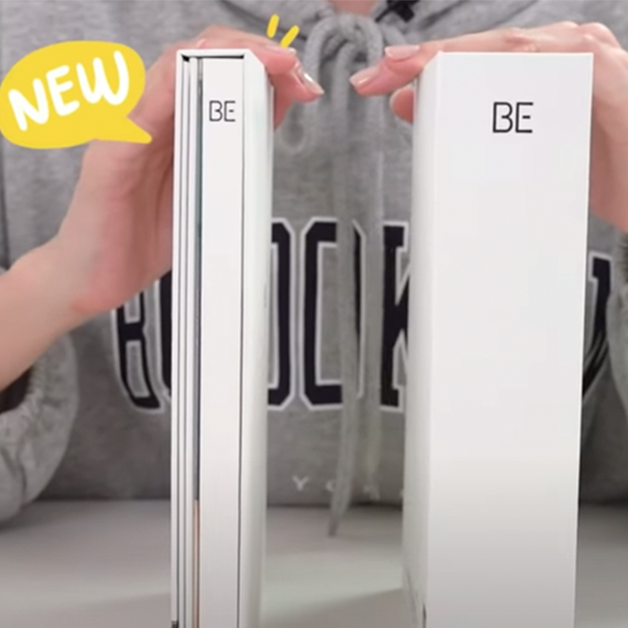
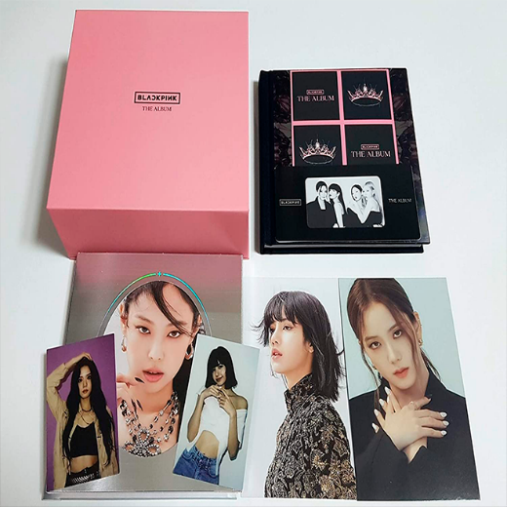
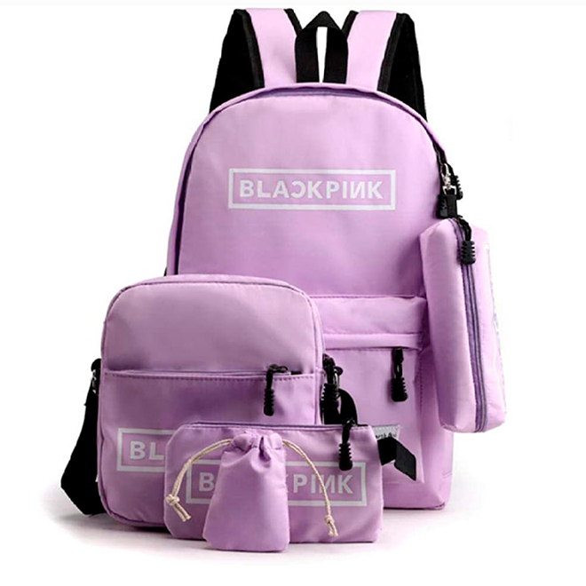
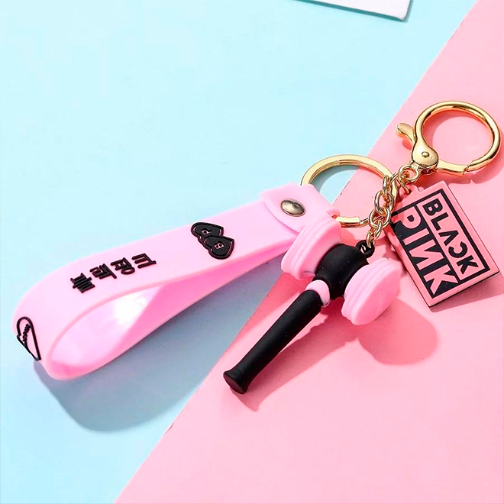

Butter Single album with PREORDER. GET IT NOW
KPOP KITTEN KAWAII
KPOP PLAYERA
KPOP HARAJUKU
HARAJUKU T-SHIRT
BTS WORLD OST
BTS BE DELUXE
BLACKPINK ALBUM
BLACPINK BAG SET
BLACPINK LLAVERO
HARAYUKU BLACKW

Slide 5
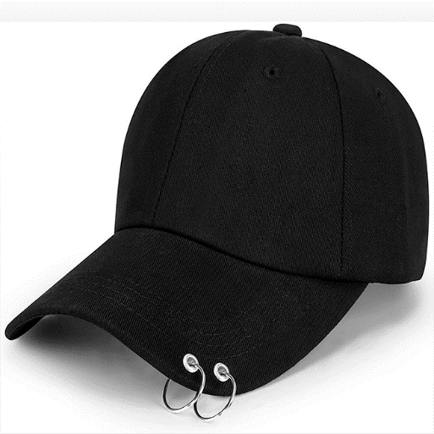
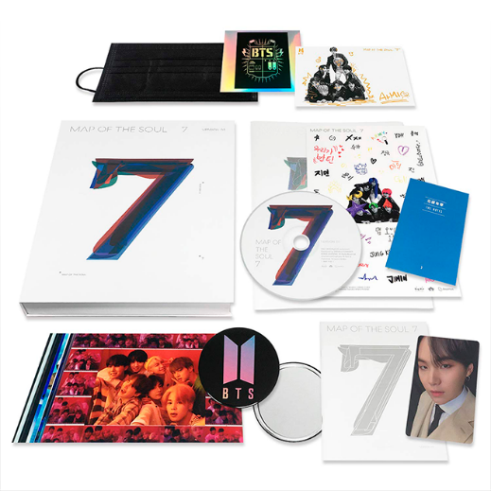
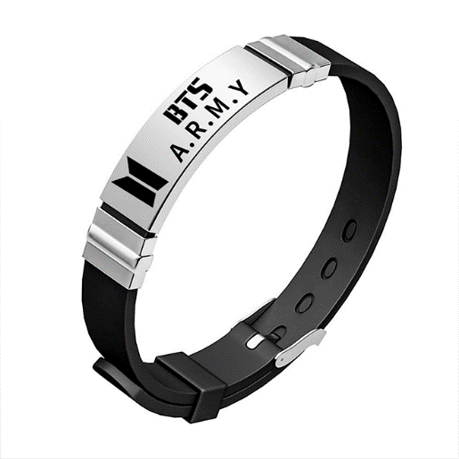
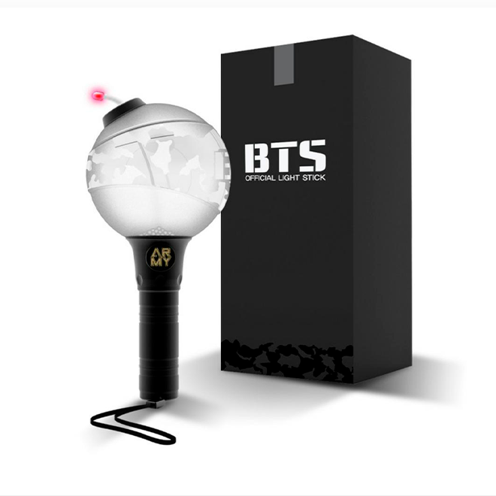
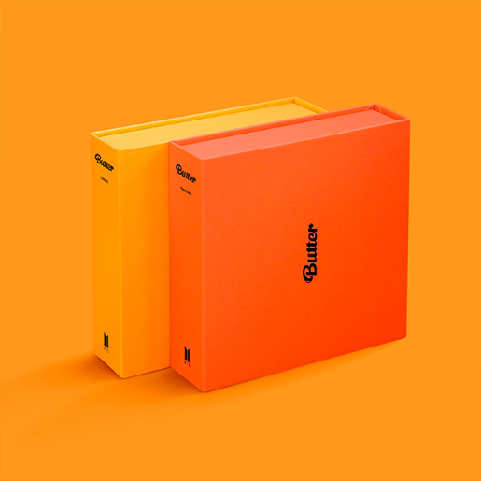
Butter Single album with PREORDER. GET IT NOW
JIMIN GORRA
BTS MAP SOUL 7
BRAZALETE ARMY
BTS ARMY LIGHSTICK
HARAYUKU BLACKW

Slide 6
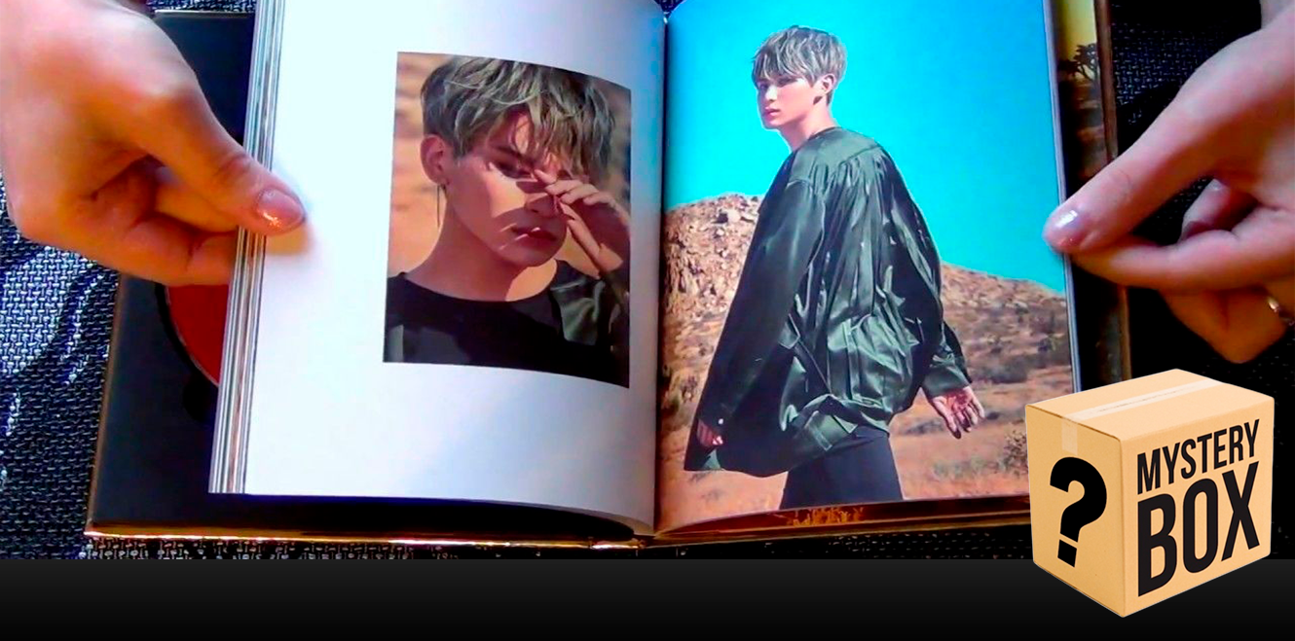
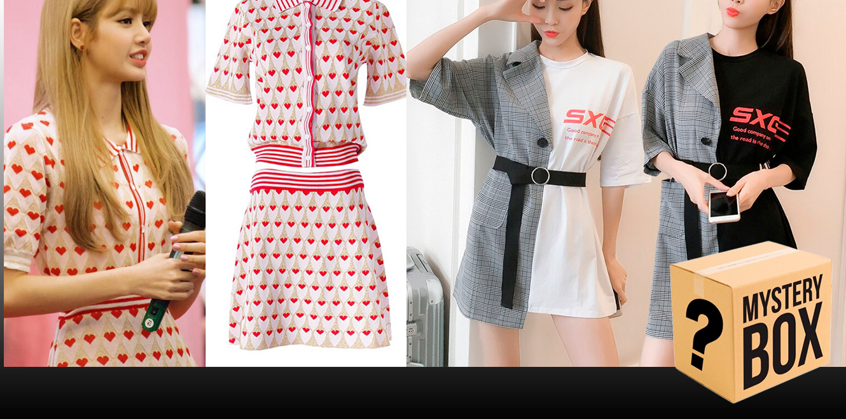
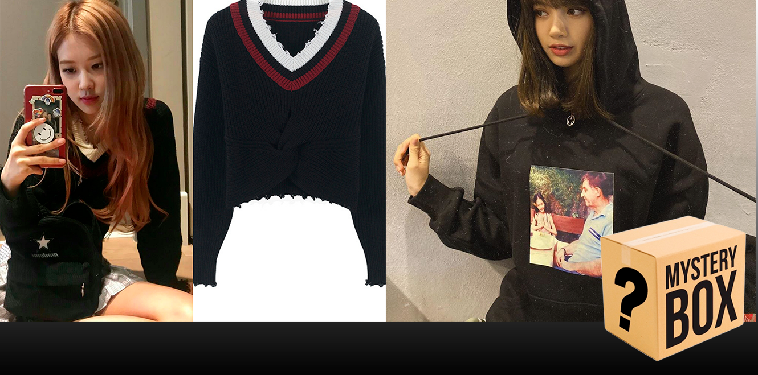
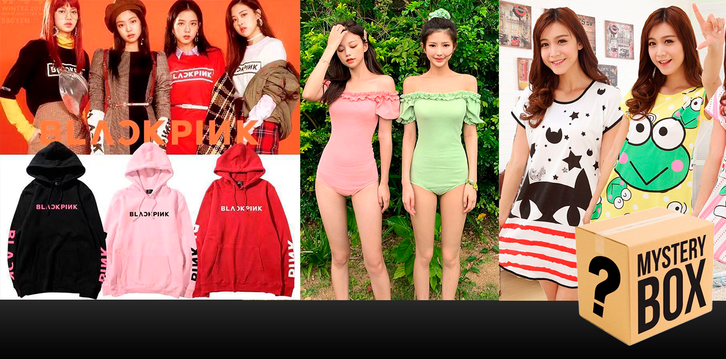
Butter Single album with PREORDER. GET IT NOW
KPOP UNBOXING
KPOP WHOLESALE BOX
BLACPINK UNBOXING
KOREAN WHOLESALE UNBOXING

Slide 7
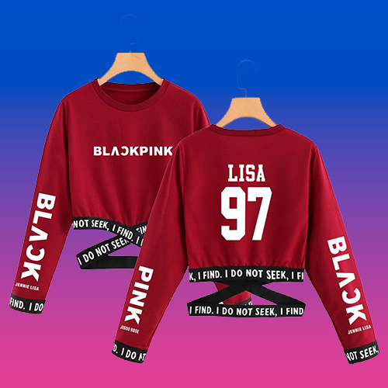
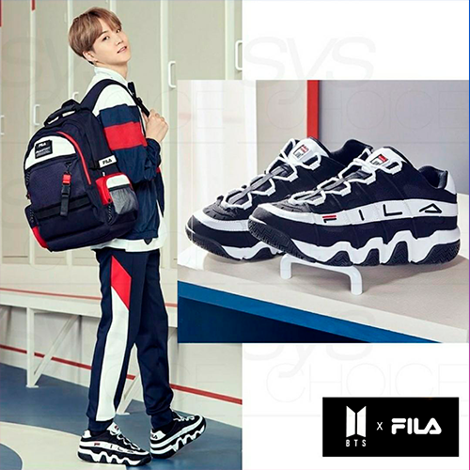
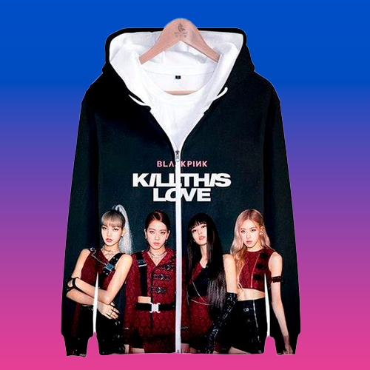
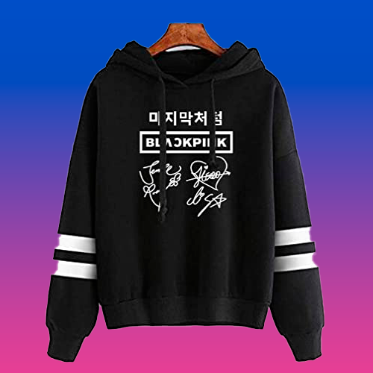
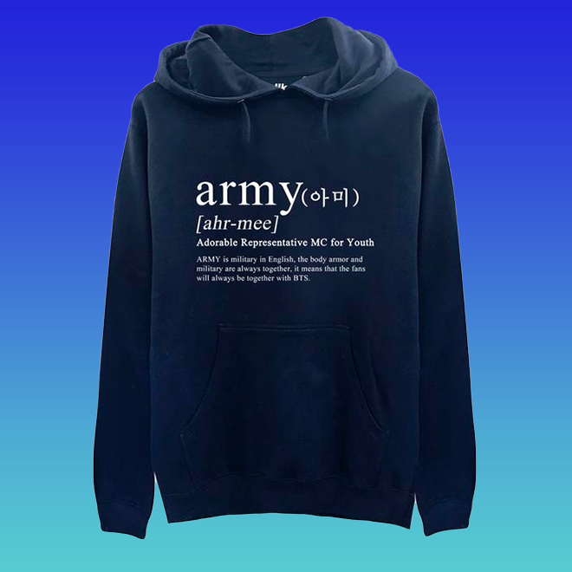
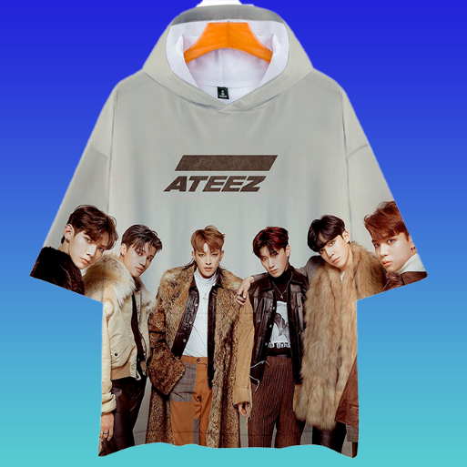
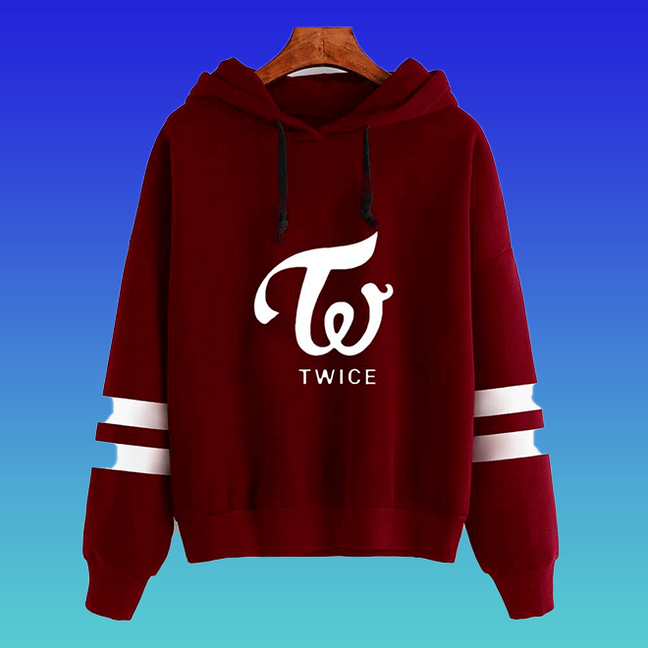
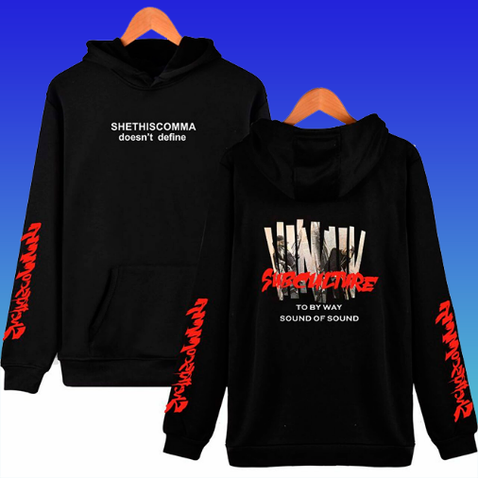

Butter Single album with PREORDER. GET IT NOW
LISA SWEATER
BTS FILA
BLACKPINK KILL LOVE
BLACKPINK HOODIE
ARMY HOODIE
T-SHIRT KPOP
TWICE HOODIE
KPOP HOODIE
BUTTER BAG

